Slide 1

Internship Task 1
Introduction to Data Science, AI, ML & Python Programming
Presenter: Nilakanth Talawar

Slide 2

FOUNDATIONS
What is Data Science, AI & ML?
Data Science
Artificial Intelligence (AI)
Machine Learning (ML)
An interdisciplinary field that extracts insights and knowledge from structured and unstructured data using scientific methods, algorithms, and systems. It combines statistics, programming, and domain expertise to solve real-world problems.
The simulation of human intelligence in machines programmed to think, learn, and solve problems. AI systems can perform tasks like speech recognition, decision-making, and visual perception that typically require human intelligence.
A subset of AI that enables systems to automatically learn and improve from experience without being explicitly programmed. ML algorithms build mathematical models based on training data to make predictions or decisions.

Slide 3
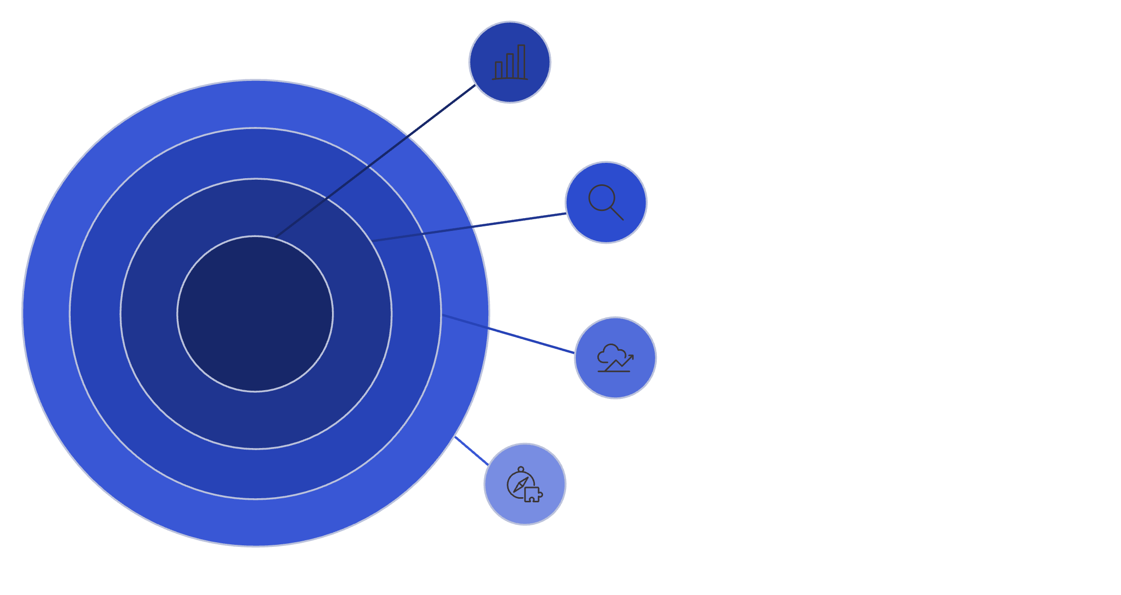




Types of Data Analysis
Descriptive
What happened in the past.
Understanding the Analysis Spectrum
Diagnostic
Why something happened.
Descriptive: Summarizes historical data to identify patterns and trends
Diagnostic: Examines data to determine why something happened
Predictive: Uses statistical models to forecast future outcomes
Prescriptive: Recommends actions to achieve desired results
Predictive
What is likely to happen.
Prescriptive
What action to take.
Data analysis evolves from understanding past events to predicting and shaping future outcomes through increasingly sophisticated techniques.

Slide 4

PROCESS
Data Science Project Lifecycle
Business Understanding
1
Define objectives, identify key stakeholders, and determine success metrics for the project
2
Data Collection
Gather relevant data from various sources including databases, APIs, and external datasets
Data Preparation
3
Clean, transform, and structure data for analysis by handling missing values and outliers
4
Exploratory Analysis
Visualize and analyze data to discover patterns, relationships, and insights
Modeling
5
Build and train machine learning models, then evaluate their performance
6
Deployment
Implement the solution in production and monitor its ongoing performance

Slide 5




Real-World Applications of Data Science
Healthcare
Finance
E-Commerce
Smart Cities
Disease prediction, drug discovery, personalized treatment plans, and medical imaging analysis
Fraud detection, risk assessment, algorithmic trading, and credit scoring systems
Product recommendations, dynamic pricing, customer segmentation, and inventory optimization
Traffic optimization, energy management, public safety monitoring, and urban planning

Slide 6

PROGRAMMING
What is Python Programming?
Python is a high-level, interpreted programming language known for its simplicity and readability. Created by Guido van Rossum in 1991, Python emphasizes code readability with its use of significant indentation and clean syntax.
Why Python for Data Science?
Simple, readable syntax
Extensive library ecosystem
Strong community support
Cross-platform compatibility
Rapid prototyping capabilities
Python supports multiple programming paradigms including procedural, object-oriented, and functional programming. Its versatility makes it ideal for beginners while remaining powerful enough for complex applications in data science, web development, and automation.
"Python is an easy to learn, powerful programming language with efficient high-level data structures."

Slide 7



Python: Features, Advantages & Libraries
Key Features
Core Advantages
Essential Libraries
Easy to learn and read with English-like syntax
Interpreted language with dynamic typing
Object-oriented and supports multiple paradigms
Automatic memory management
Massive community and documentation
Free and open-source
Platform independent (Windows, Mac, Linux)
Integrates easily with other languages
NumPy: Numerical computing and arrays
Pandas: Data manipulation and analysis
Scikit-learn: Machine learning algorithms
TensorFlow/PyTorch: Deep learning frameworks
Matplotlib/Seaborn: Data visualization

Slide 8






Career Roles in Data Science
Data Analyst
Data Engineer
Machine Learning Engineer
Data Scientist
Interprets data, creates reports, and provides actionable insights using statistical tools and visualization techniques
Builds and maintains data pipelines, databases, and infrastructure for data processing and storage
Combines statistics, programming, and domain knowledge to solve complex problems and build predictive models
Designs and implements ML models, optimizes algorithms, and deploys AI solutions in production
BI Developer
AI Researcher
Creates dashboards and reporting tools to help organizations make data-driven business decisions
Develops cutting-edge AI algorithms, publishes research, and advances the field of artificial intelligence

Slide 9


BEST PRACTICES
Rules of Python Programming
1
Indentation is Mandatory
PEP 8 Style Guide
Python uses whitespace indentation (4 spaces) to define code blocks instead of braces
Python Enhancement Proposal 8 (PEP 8) provides coding conventions for writing clean, readable Python code.
2
Case Sensitivity Matters
Additional Guidelines
Variables like 'name' and 'Name' are treated as completely different identifiers
Keep lines under 79 characters
Import statements at the top of files
Avoid using reserved keywords as names
Follow the Zen of Python: "Simple is better than complex"
3
Use Meaningful Names
Variable and function names should be descriptive and follow snake_case convention
4
Comment Your Code
Use # for single-line and ''' ''' for multi-line comments to explain complex logic

Slide 10
THANK YOU….!

